Slide 1
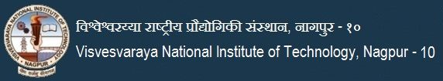

Autonomous Presentation Creator
(for educational purposes only)
Project Phase II (ECD402)
Evaluation 3 (May 9th, 2021 , Monday)
PROJECT TEAM MEMBERS NAME OF SUPERVISOR
1. Pushpesh Raj (BT18ECE072) Dr. Anamika Singh
2. Mayank Bumb (BT18ECE111)
3. Ramisetti Sai Mounish (BT18ECE131)
4. Abdul Majid Khan (BT18ECE135)

Slide 2
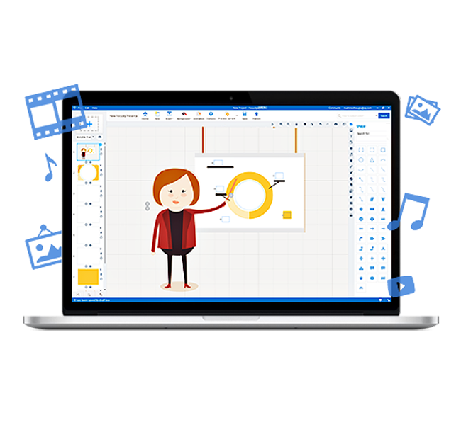
Contents
Problem Statement
Block diagram
Timeline
Literature Survey
Web Scraping
XLNet Model
BART Model
Python-pptx
Work to be done in the next evaluation
Conclusion

Slide 3
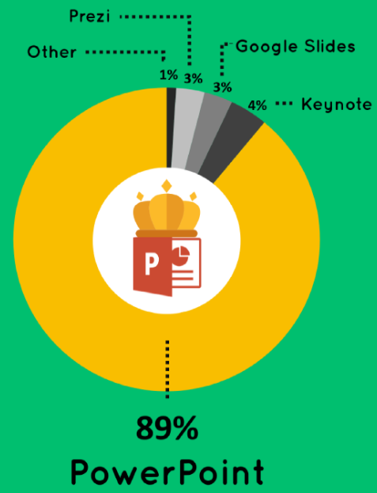
Problem Statement
An Autonomous Presentation Creator utilising minimum inputs from the user.
Autonomous Presentation Creator utilizing
Web Scraping
Text summarisation using NLP
Image extraction along with their captions
Presentation Design
Notes:
add statistics of powerpoint
Smart art
No solution strategy required
Remove Repetition

Slide 4
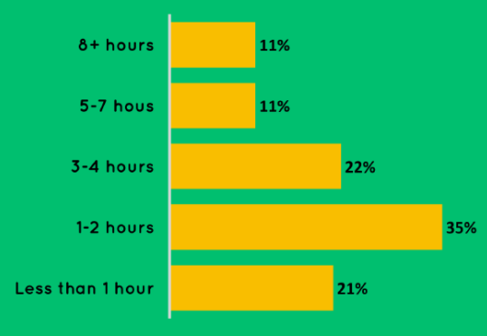
Time consumed Potential Market
1
Number of users
500 million worldwide
2
Number of presentations created daily
30 million worldwide
3
Use of presentation for teachers
6 million teachers use it
4
120 million worldwide
Use of presentation for business and education
5
Estimated sale of presentations
100 million dollars
Notes:
Add on the right side

Slide 5
Timeline for the Project Completion
Selecting problem statement
Implementing Web Scraping
Text summarisation using few other models like MASS, Pegasus, BART-RXF
Exploring and analysing SOTA models for image relevancy.
Try out few other combinations to get state of the art accuracy for images.
Successful completion of autonomous presentation creator
July-21
Aug-21
Sept-21
Oct-21
Nov-21
Dec-21
Jan-22
Feb-22
Mar-22
April-22
May-22
Jun-22
Exploring and analysing SOTA models for text summarisation.
Text summarisation using BERT model
Trying out beam search and few other combinations to get state of the accuracy
Implementing few SOTA models for images.
Compiling all this into presentation using python libraries
Pitch it to some firm or get a patent out of it.

Slide 6
Block diagram
Topic and difficulty level
Getting input from the user
Web scraping
Crawl the data from web to get various related texts
Text summarisation
Summarize the corpus of text using transformer model
Image relevance
Add most relevant images to the Presentation.
Refining
Refine the presentation by using graphics
Presentation
Using python library to output the Presentation
Notes:
1 line text corresponding to all

Slide 7
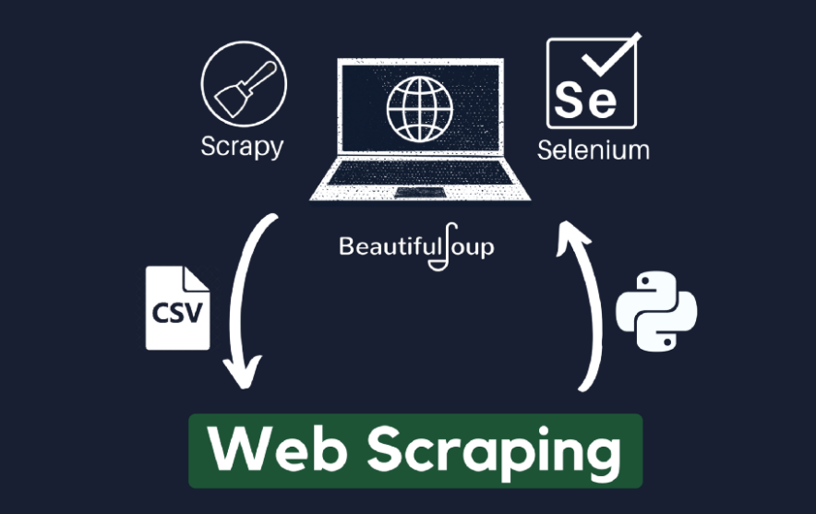
Web Scraping
The Data required for making the presentation is scraped from the wikipedia sources and urlopen package is used to open URL(HTTP).
Beautiful Soup framework in Python library is used for web scraping to pull the data from the HTML file of our corresponding web page provided by the user.

Slide 8
CLASSIFICATION OF DATA INTO SEGMENTS
Topic as input is stored along with Wikipedia domain as a string.
Using Beautiful soup for HTML and selenium for scraping different URLs.
Ordered tree traversal for the division of classes separately on each subtopic.
Extracting headlines and corresponding images from that section.
Iteration to extract paragraph from <p> tag.
Cleaning of the string.

Slide 9
Final Steps involved in Scraping of Data and Images in Classified Groups
First the input is taken as a string from the user and it is appended with Wikipedia domain name so that we can get the finalise url of the corresponding topic.
Once we got the url we use urlopen package to open the url.
After this beautiful soup library is used to get the html file for the url.
Then we use soup.find_all function present in beautiful soup for ordered traversal in the HTML file.
While traversing in html file we extract different types of heading (i.e from heading 1 to heading 3) using H1 to H3 tags.

Slide 10
Continued…
The heading tags are taken individually and are divided as subtopic segments.
Basically we are classifying the whole ppt into segments using these subtopics.
Then for each of these segment we are extracting the paragraph as p tag and store it as a string.
The next stage is cleaning these paragraph string as it contains several irregularities like numeric keyword for reference and black slash n as it is used in html to end the line.
These paragraphs are main content which we process in our NLP part.

Slide 11
Continued…
Along with the paragraph we extract all the URLs of images using image attributes and anchor tags.
We use these images url and append the image along with paragraph in the final ppt whose process will be explained later in this presentation.
Along with the images, their description is also extracted using caption tag.
All these information of each subsegment is passed further in the form of dictionary which we use later in this project.

Slide 12
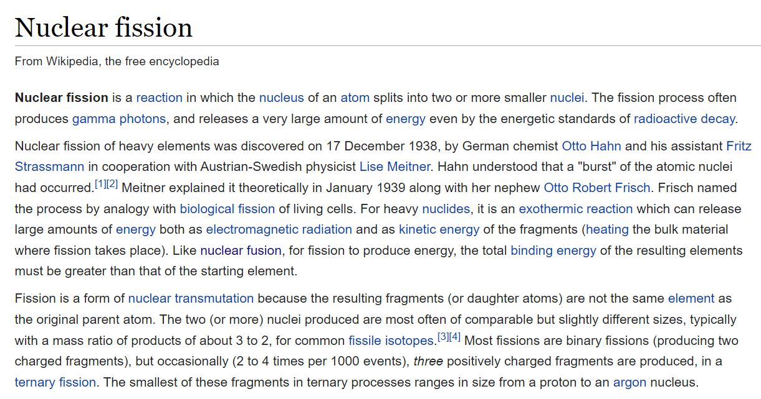
Image of Input for Text extraction

Slide 13
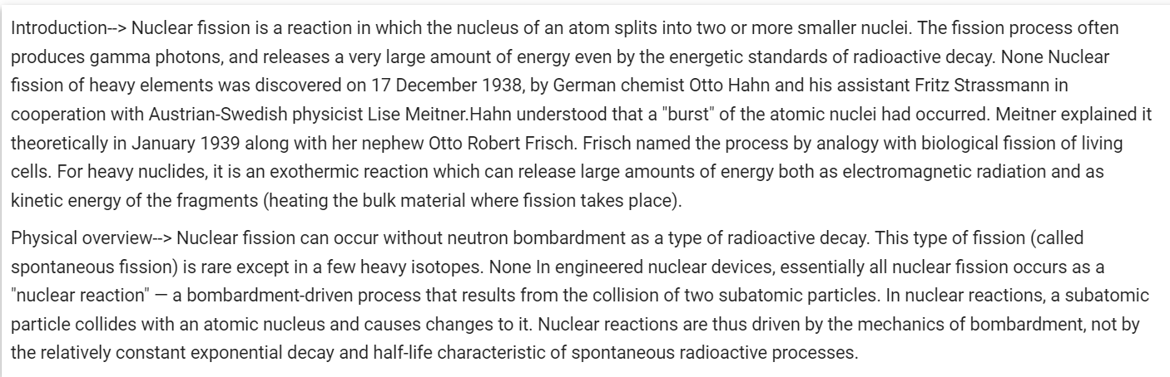
Output after classification of extracted text

Slide 14
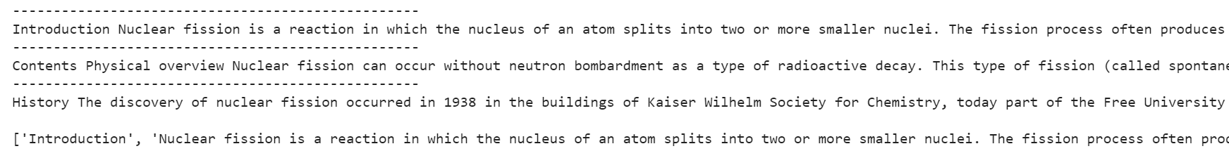
Screenshot 1
Screenshot 2

Slide 15
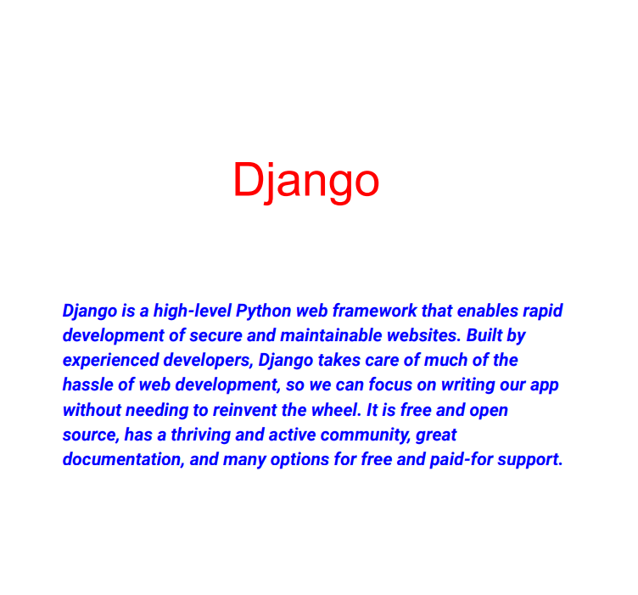
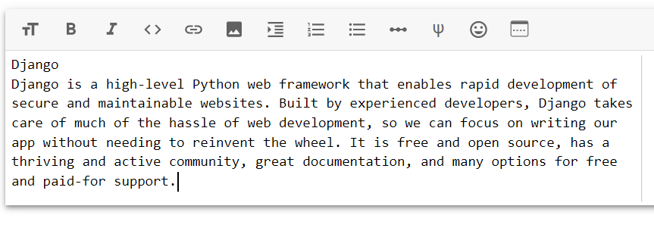
Extraction from Pdf (given by user)
Screenshot of output of text extracted from pdf

Slide 16
Image Scraping
The images in the Wikipedia page can be extracted using BeautifulSoup.
A function is built using urlopen(), BeautifulSoup(), and soup.find_all() to get urls of images in a list.
The ‘soup’ in soup.find_all is obtained using BeautifulSoup.
Soup.find_all has many parameters(search terms) of which the most important ones are Tag name and Class_.
As far as images are concerned the search terms are “a” and class_=”image”.
From the urls obtained from find_all method, only those that contain ‘src’ attribute are to be appended in the URL list.

Slide 17
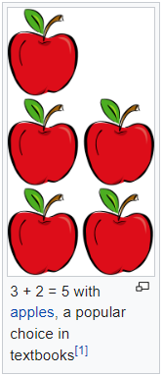
Image Scraping (Along with Caption)
From the above process we can get the image or its URL but we need the caption(image description) too!
From the adjacent figure, “3+2 = 5 with apples, a popular choice in textbooks” is the image description and we need to extract this along with image.
So firstly we need to collect urls of all the image descriptions in a list along with the image URL list.
Just like extraction of image URLs, we use ‘soup.find_all’ with “div” as head and “thumbinner” as class to extract the image descriptions of all the images i.e. “div” and class_=”thumbinner” are the parameters in soup.find_all.
Now we have a list with all the image urls and another list with all the captions.

Slide 18
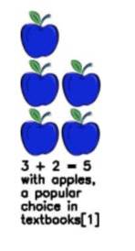
Image Scraping
(Joining image and caption)
After getting lists of image urls and image descriptions, our job is to combine both i.e, join the corresponding image description at the bottom of the image.
This can be done using OpenCV or PIL and NumPy.
The image array(img) and description box array(temp) should be created and concatenated together. The height of img and temp will be same and the width of temp will be decided based on the number of characters in the caption.
Now the text can be drawn on the concatenated image using cv2.putText. One can manually decide the font, font colour, line thickness etc. of the text.
The images achieved after this process look like the adjacent figure.

Slide 19
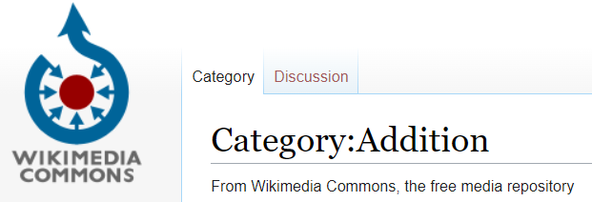
Copyright clarification for usage of images from Wikipedia
Most of the images on Wikipedia are non copyrighted. Very few images which cannot be replaced by free images (like company logos etc.,) are copyrighted.
But these can be used for non-commercial or educational purposes by referencing the source.
Also there is a sister project of Wikipedia called Wikimedia Commons in which all the images related to a topic are non copyrighted!!
All the images from Wikipedia Commons are free to use for any purposes.

Slide 20
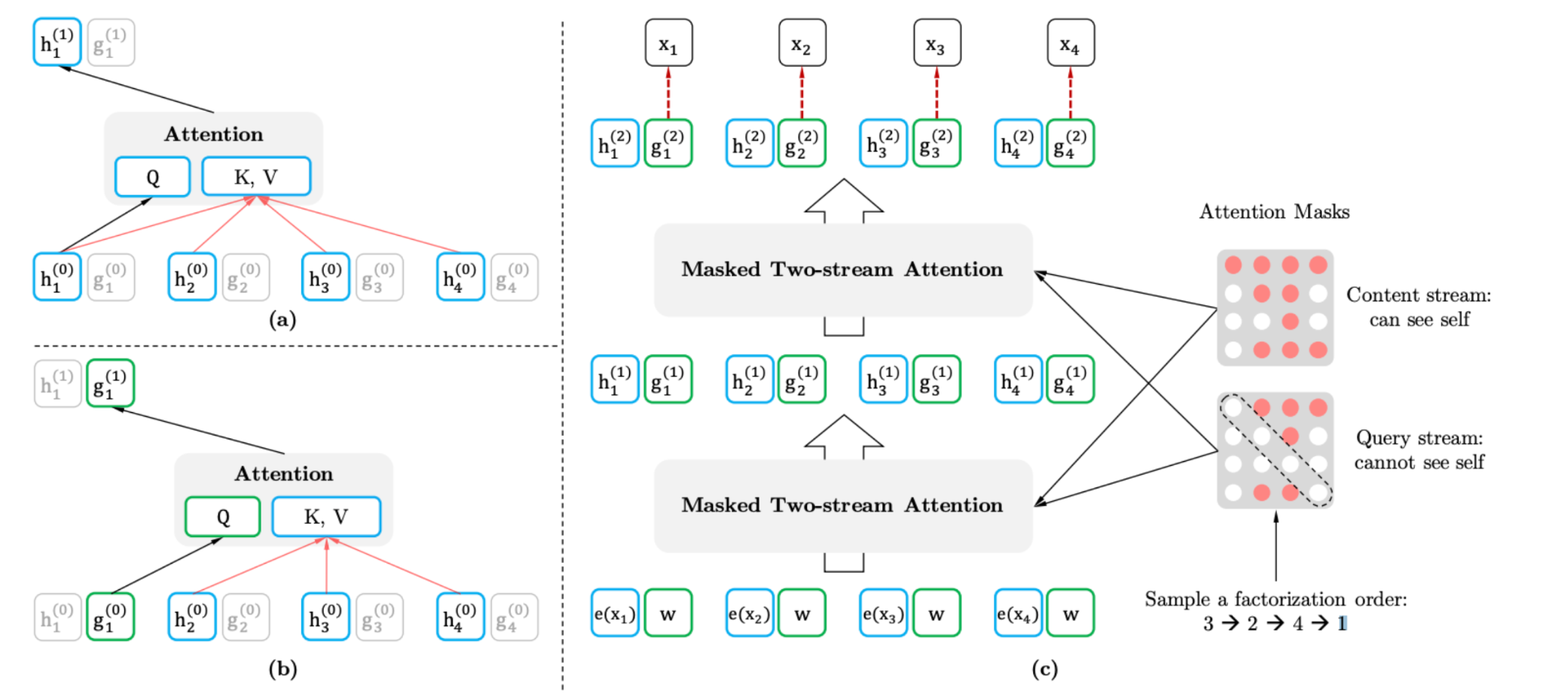
XLNet MODEL
2019
Datasets :
Custom
XLNet is a generalized autoregressive model where next token is dependent on all previous tokens.
It integrates the idea of auto-regressive models and bi-directional context modeling, yet overcoming the disadvantages of BERT.
BERT masks the data and tries to predict the masked data using a bi-directional context whereas XLNet uses permutation objective.

Slide 21
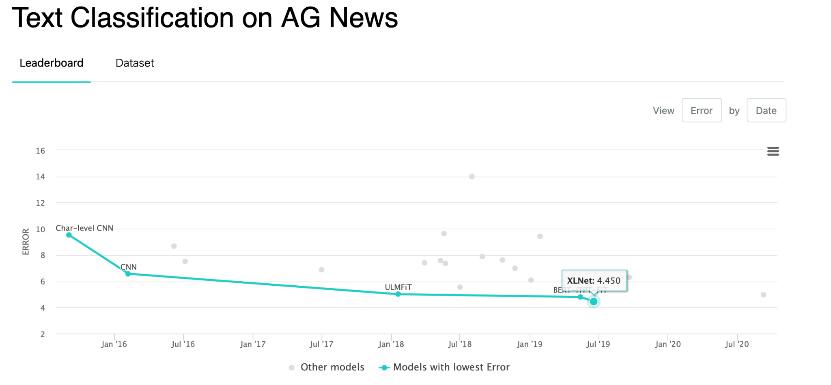
Comparison of best models

Slide 22
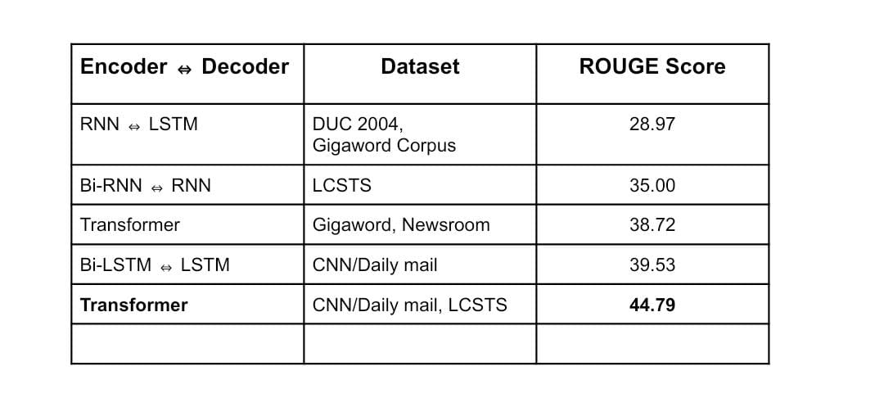
Comparison and Literature Survey Conclusions
ROUGE is a classification based dataset that assigns a score corresponding to the accuracy of a bot generated summary to that of a human written one.

Slide 23
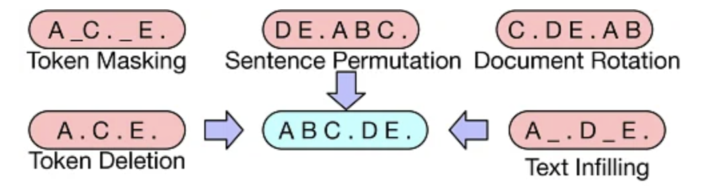
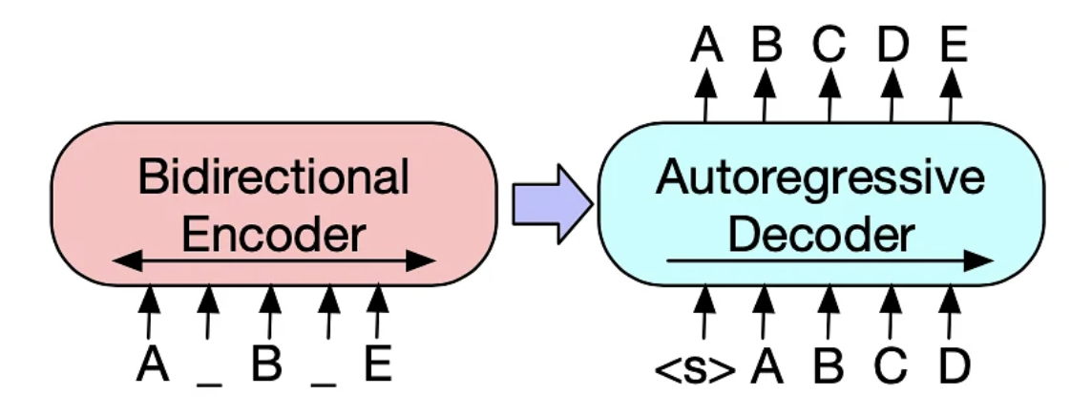
BART MODEL
2019
Datasets :
CNN news
Bidirectional and Auto-Regressive Transformer [1][2]
BART is a sequence-to-sequence model trained as a denoising autoencoder.
The BART model can be fine-tuned to domain-specific datasets to develop applications
Bidirectional encoder(BERT): It uses both the information from left and right in the text to find the best representation of its input sequence.
Autoregressive decoder(GPT): It means that it produces output from the hidden state which is the output of the encoder. This subsequently goes into a recurrent structure that uses prediction from previous state to generate next step.

Slide 24
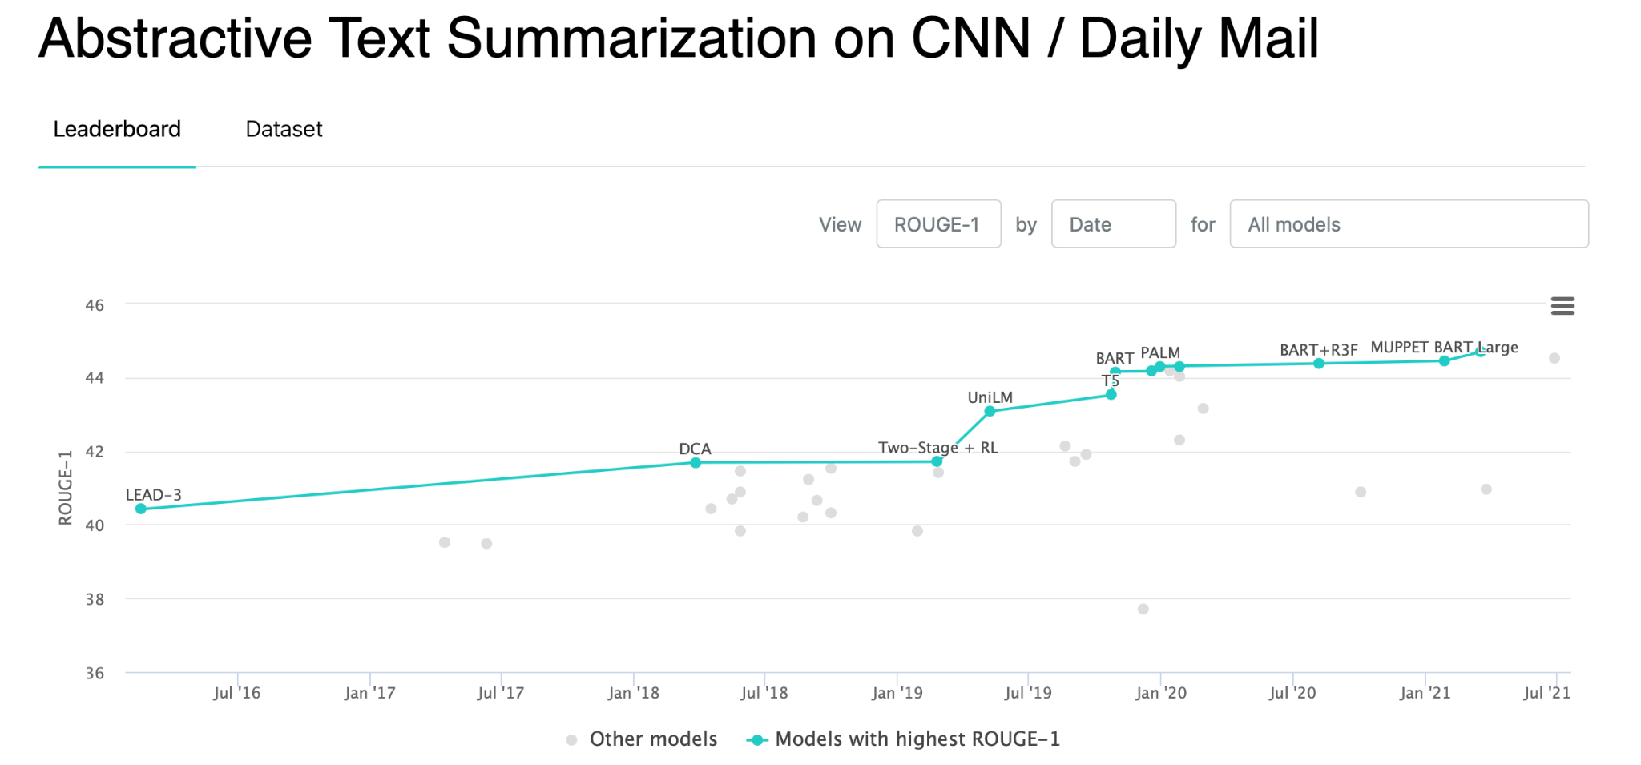
Comparison of best models

Slide 25
IMPLEMENTATION OF TEXT SUMMARIZATION MODELS
Summarization of addition from wikipedia using BART model
The addition of two whole numbers results in the total amount or sum of those values combined.
Addition belongs to arithmetic, a branch of mathematics.
Performing addition is one of the simplest numerical tasks.
Summarization of addition from wikipedia using BERT model
Addition (usually signified by the plus symbol +) is one of the four basic operations of arithmetic, the other three being subtraction, multiplication and division.
Addition belongs to arithmetic, a branch of mathematics.
In algebra, another area of mathematics, addition can also be performed on abstract objects such as vectors, matrices, subspaces and subgroups.
Summarization of addition from wikipedia using NLTK library
Repeated addition of 1 is the same as counting; addition of 0 does not change a number.
Performing addition is one of the simplest numerical tasks.
Addition has several important properties.

Slide 26
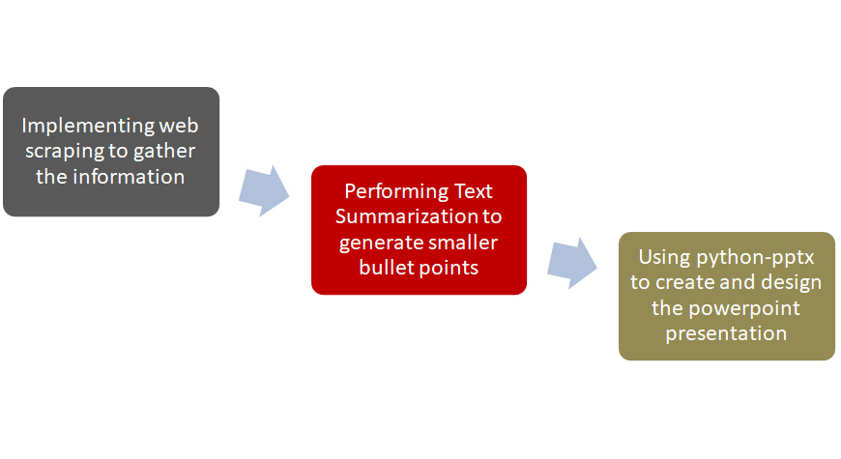
Creating and Design of a PowerPoint Presentation

Slide 27
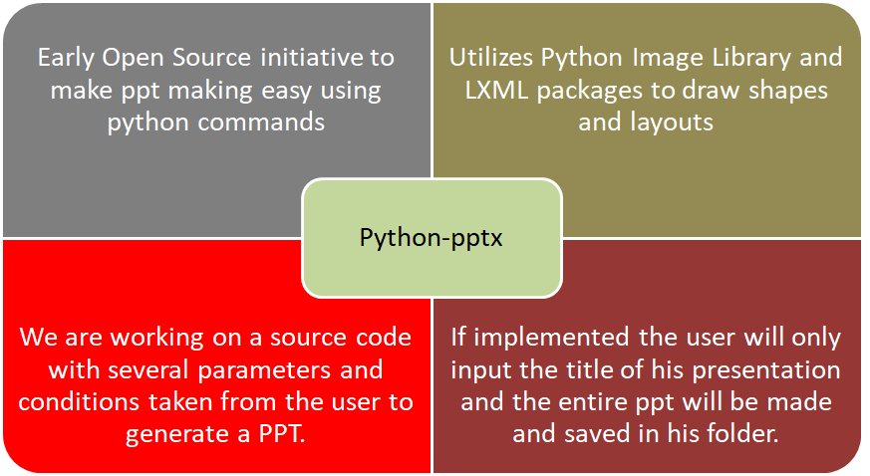
Introduction to Python-pptx

Slide 28
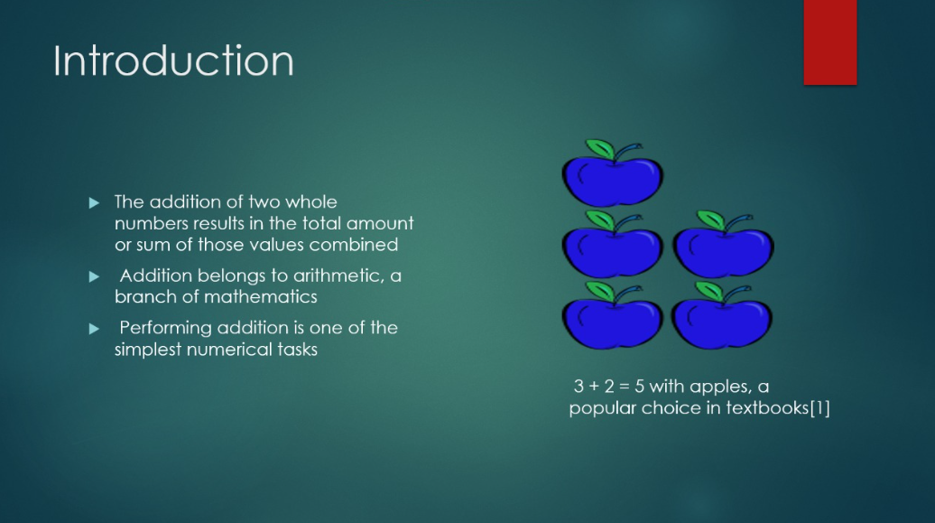
Themes of PPT
Objects in VBscript is created.
These objects are basically presented as layouts.
Different layouts for slides of PPT are given to the user depending on his/her needs.

Slide 29
Demonstration of working of python-pptx

Slide 30
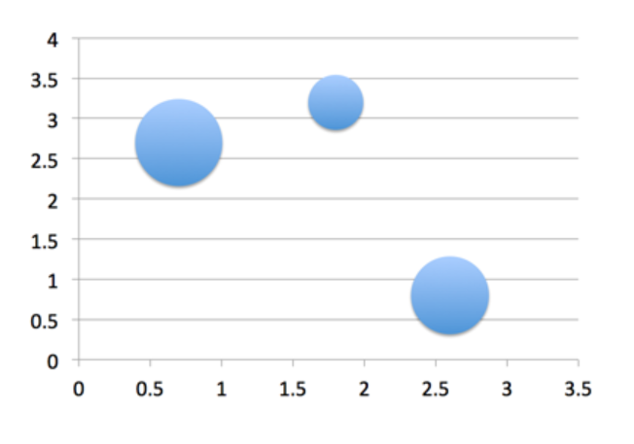
DATA VISUALISATION ASPECT
Statistical Data -> Graphs
More Visuals
Requires dedicated statistical data scraping algorithm

Slide 31
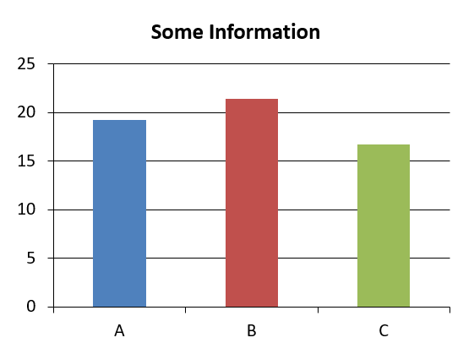
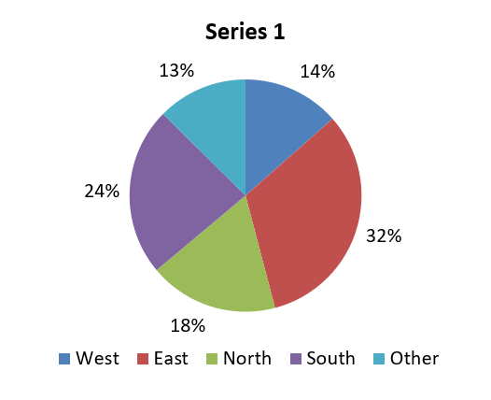
Further Implementations of python-pptx

Slide 32
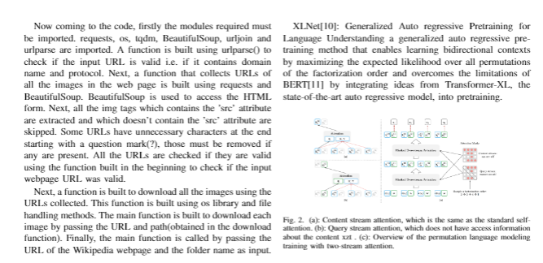
RESEARCH PAPER

Slide 33
References
Devlin, Jacob, et al. "Bert: Pre-training of deep bidirectional transformers for language understanding." arXiv preprint arXiv:1810.04805 (2018).
Canete, José, et al. "Spanish pre-trained bert model and evaluation data." Pml4dc at iclr 2020 (2020).
Vaswani, Ashish, et al. "Attention is all you need." Advances in neural information processing systems. 2017.
Suleiman, Dima, and Arafat Awajan. "Deep learning based abstractive text summarization: Approaches, datasets, evaluation measures, and challenges." Mathematical Problems in Engineering 2020 (2020).
Syed, Ayesha Ayub, Ford Lumban Gaol, and Tokuro Matsuo. "A Survey of the State-of-the-Art Models in Neural Abstractive Text Summarization." IEEE Access 9 (2021): 13248-13265.
Pennington, Jeffrey, Richard Socher, and Christopher D. Manning. "Glove: Global vectors for word representation." Proceedings of the 2014 conference on empirical methods in natural language processing (EMNLP). 2014.
Elman, Jeffrey L. "Finding structure in time." Cognitive science 14.2 (1990): 179-211.
Hochreiter, Sepp, and Jürgen Schmidhuber. "Long short-term memory." Neural computation 9.8 (1997): 1735-1780.
Chung, Junyoung, et al. "Empirical evaluation of gated recurrent neural networks on sequence modeling." arXiv preprint arXiv:1412.3555 (2014).
python-pptx — python-pptx 0.6.21 documentation

Slide 34
Work to be Done by the Next Evaluation
Research Paper presentation
Image Enhancement
Web App
Images and text are scraped from the research paper using OCR. Using these data presentation can be created.
As images scraped from wikipedia pages are of different size, it is required to enhance the image so that it can fit for corresponding dimensions.
Web application for autonomous PPT .

Slide 35
Work to be Done by the Next Evaluation
Fine Tuning BERT Model
Classification of Sentences
Web Scraping
Several other techniques such as pre training and beam search can be further implemented to improve the summarisation results.
We develop a labelling algorithm that will segregate the sentences into easy medium and hard to understand. Based on this classifications our presentation can be made more interactive.
Try and improve the web scraping results by choosing more apt paragraphs and getting access of more data through crawling more sites.
Notes:
Try out 2 or 3 combination of models
Add beam search in transformer model to check for better results
Read literature about relevance of image and figure out the state of the art
Develop a source code to implement web scraping.
Shift

Slide 36
Steps involved in Scraping data.
Step 1
Specifying the URL of the web page in a string.
Step 2
Using BeautifulSoup to get the HTML file.
Step 3
Searching the paragraph(<p>) tag in HTML saving the information inside the tag.
Step 4
Cleaning the string which is made by appending paragraphs.
Step 5
Extracting other details like tables information in similar manner as text
Step 6
Using the string in NLP.

Slide 37
BART MODEL

Slide 38
WORKING OF THE SUMMARIZER

Slide 39
DEMONSTRATION OF WORKING

Slide 40
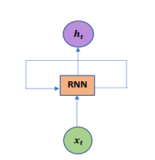
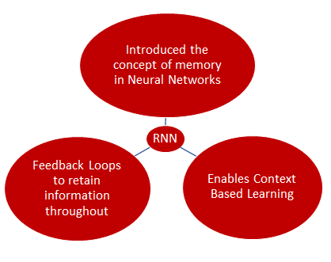
Literature Survey on Abstractive Text Summarisation
1982^{[7]}
Datasets :
CNN/DailyMail
Newsroom
Gigaword
DUC 2004
Recurrent Neural Networks RNN^{[7]}
Recurrent Neural Network Unit^{[5]}
h_{t} = tanh (ω_{h}h_{t−1} + ω_{x} x_{t} )^{[5]}
h_{t} = current state
h_{t-1}= previous state
ω = weight
x_{t} = current input

Slide 41
Mathematical framework of sequence-sequence modelling
RECURRENT NEURAL NETWORKS (RNN) | GATED RECURRENT UNIT (GRU) | LONG SHORT TERM MEMORY (LSTM)
Uses simple multiplication of input and previous input. Doesn’t use any Gates. | An update gate is introduced to decide if previous output should be passed to the next cell. Also has reset gate to determine if past info is useful | 2 additional Gates are used. Forget - Decide if previous info should be kept Output Gate - Controls parts of cells to output.
Faces Short Term memory problem due to vanishing gradient. Difficult to preserve information over many timesteps | Attempts to solve vanishing gradient by introducing gates to control info flow. | Attempts to solve Vanishing Gradient by introducing the forget and the output gate.
Since utilizes the short memory logic training time is faster albeit not very effective | Works better when less training data is involved since they are simpler to modify and form. Since they use a gate they are more computational than RNN’s | LSTMs are capable of retaining longer sequences therefore are state of the art when it comes to modelling long relations. But is computationally heavy as a drawback.
Notes:
Draw an arrow corresponding to developments including date stamp.
Mathematical Framework for seq2seq models
Citations

Slide 42
XLNET

Slide 43

Transformer Model [4][5]
2017
Datasets :
CNN
Newsroom
Gigaword
DUC 2004
Input sequence is passed in parallel which saves a lot of computational time
Convert words to vectors using GloVe[6] and adding it with Positional encoder
Passed into encoder block where attention mechanism[3] is implemented
Similarly shifted output word also goes through same process
Both the input and output attention vectors are passed into another encoder-decoder attention block
Then it is passed into the linear layer which contains neurons equal to the number of dictionary words whose softmax is calculated to get the best fit word.
Notes:
Input sequence is passed in parallel and hence saving a lot of computational time
Input embedding
GLOVE (global vectors for word representation) - converts words to vectors
But it may be possible that the words meaning changes with its position
Positional encoder
We pass this into an encoder block
Multi-head attention
How relevant is the ith word relevant to other words in the same sentence
Then into the feed forward (makes vectors more digestible to the system)
Attention vector of output
Mask these words so that it doesn’t use the words which are yet to come
Both attention vectors(input, output) are passed into another encoder-decoder attention block (generates similar attention vectors for every english and french words)
Then feed forward
Then linear layer which contains that many number of neurons as number of french words
Then softmax
Then output

Slide 44
Web Scraping
The data required for making a presentation will be scraped from the internet.
Scrapy and Beautiful Soap are among the most used frameworks based on python that can be used to perform web scraping.
Making the presentation
After text summarisation, the summarised text is made into different bullet points.Using these points and some relevant images,presentation will be made.
This task can be done using python libraries.
Notes:
Divide it into 2 slides
Add graphics and include a horizontal
Remove Wikipedia References

Slide 45
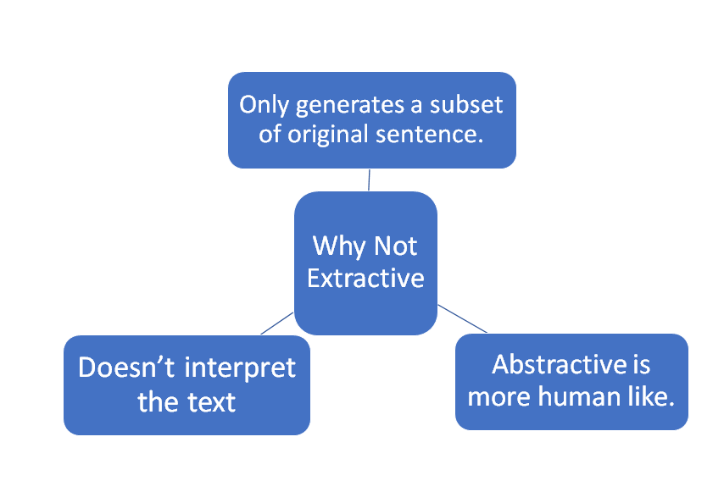
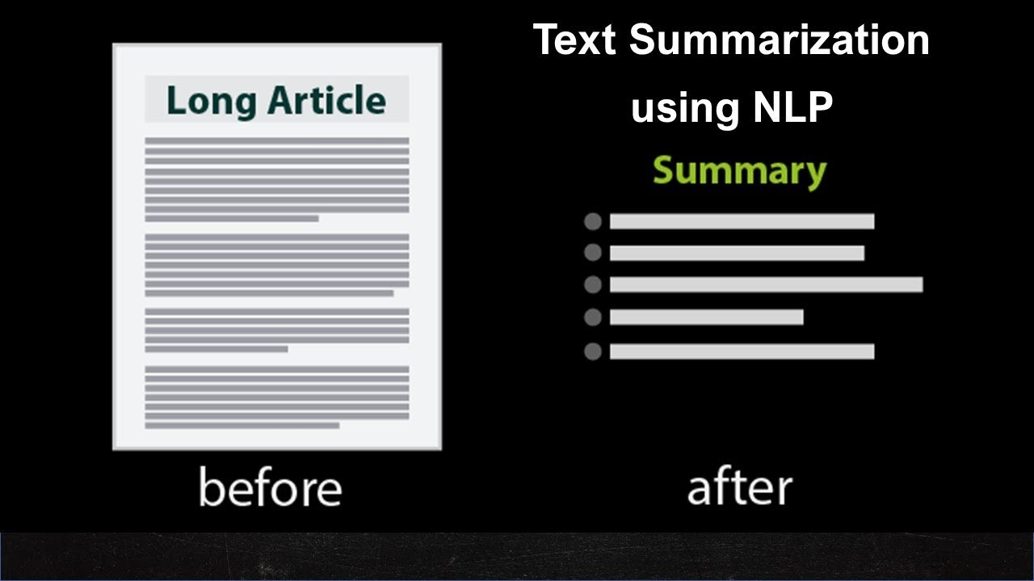
Extractive
Text Summarisation
Abstractive
‹#›

Slide 46
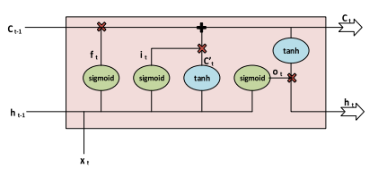
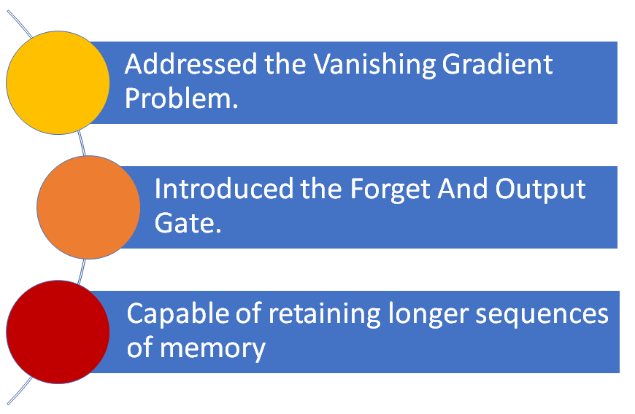
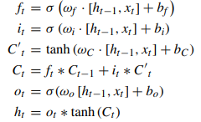
Literature Survey on Abstractive Text Summarisation
1997^{[8]}
Datasets :
CNN/DailyMail
Newsroom
Gigaword
DUC 2004
Long Short Term Memory (LSTM)^{[8]}
LSTM Cell^{[5]}
LSTM Cell and Equations^{[5]}

Slide 47
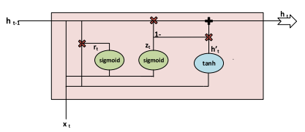
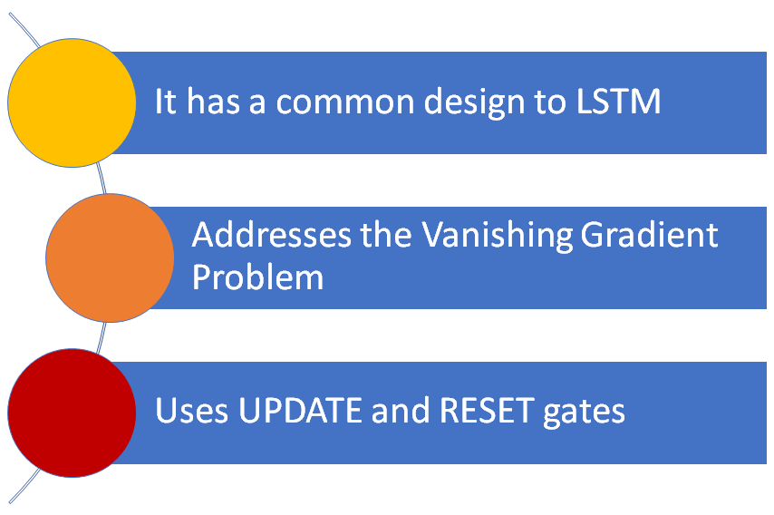
Literature Survey on Abstractive Text Summarisation
1999^{[9]}
Datasets:
CNN/DailyMail
Newsroom
Gigaword
DUC 2004
Gated Recurrent Unit^{[9]}
Gated Recurrent Unit Cell^{[5]}
z_{t} = σ (ω_{z} · [h_{t−1} , x_{t} ])
r_{t} = σ (ω_{r} · [h_{t−1} , x_{t} ])
h’_{t} = tanh (ω · [r_{t} ∗ h_{t−1} , x_{t} ])
h_{t} = (1 − z_{t} ) ∗ h_{t−1} + z_{t} ∗ h’t

Slide 48
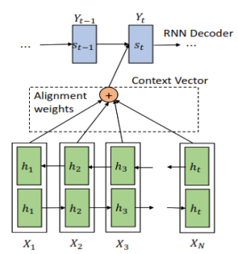
Attention^{[3]}
2017^{[3]}
Datasets:
WMT 2014
Attention is a technique that allows encoding information according to how each element is related to another.[3][5]
Self Attention
The new information is generated using the words to find the relation between sentences and those words.
General Attention
It allows the model to jointly attend to information from different representation subspaces at different positions.
Notes:
Equations should be not images
Vaswani, Ashish, et al. "Attention is all you need." Advances in neural information processing systems. 2017.

Slide 49
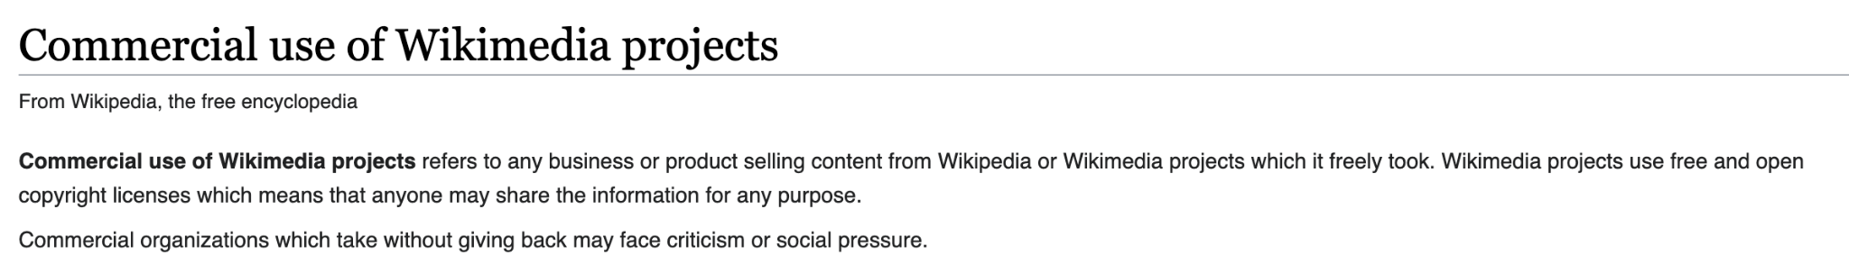
Wikipedia Copyright Clarification

Slide 50
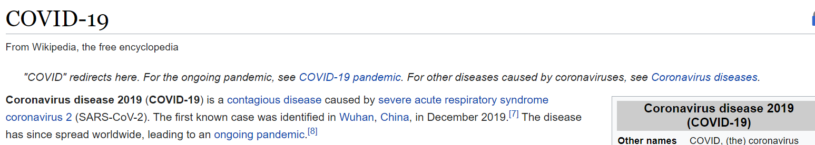
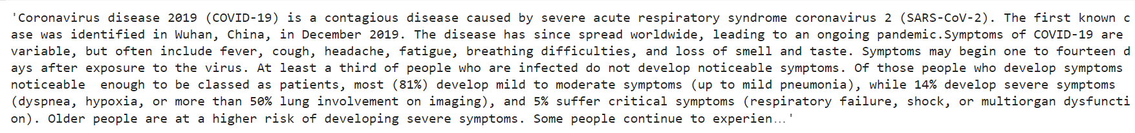
Results of Web Scraping

Slide 51
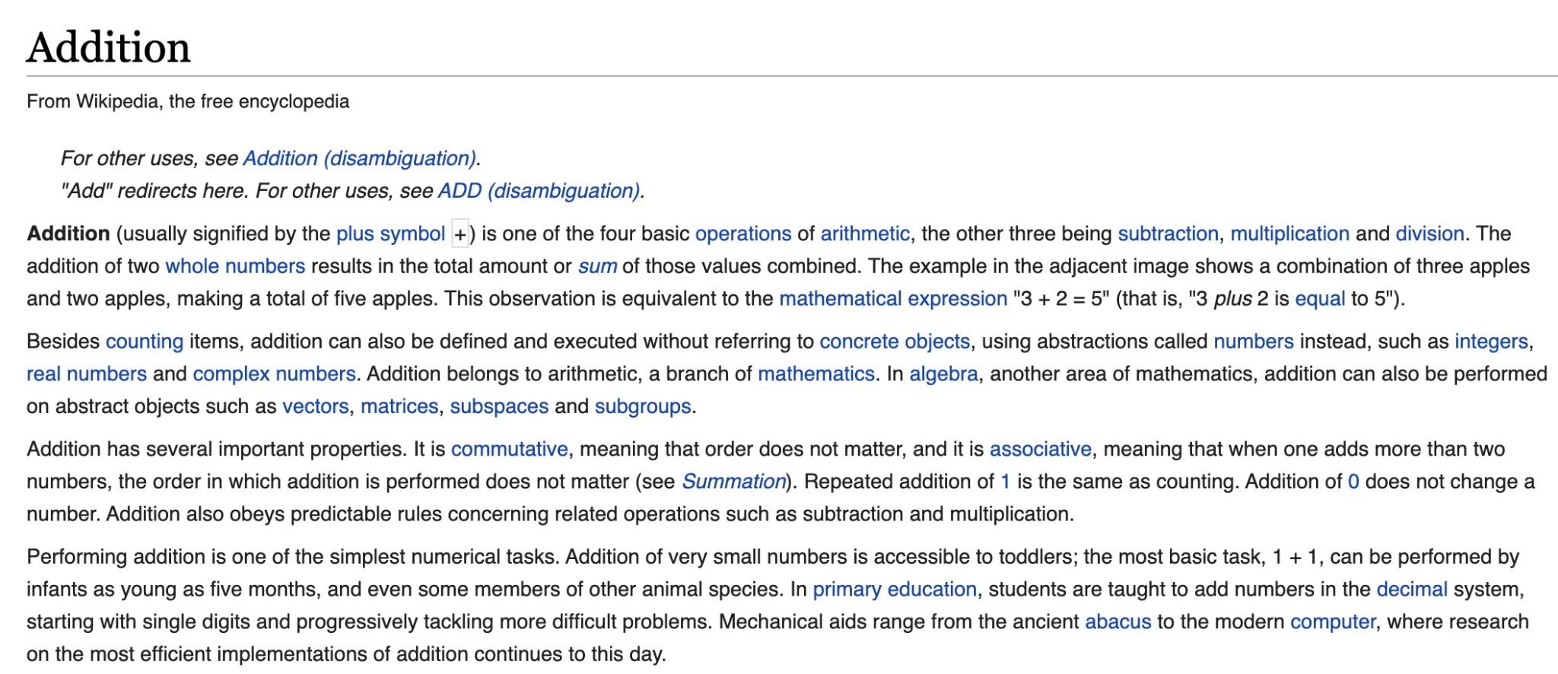
Text summarization article

